Slide 1
CONSULTANT

Slide 2
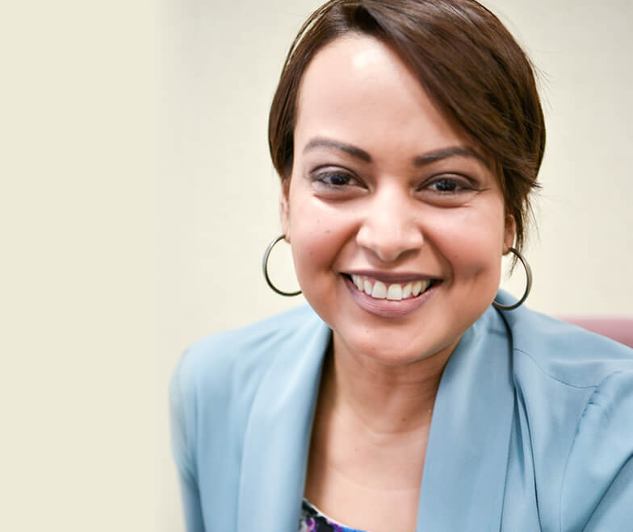
Chandra Lopez-Brooks MBC – Facilitator
Premiere Diversity & Inclusion Firm
In Silicon Valley

Slide 3
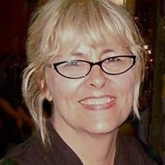
Carol Been MBC – Project Manager
Premiere Diversity & Inclusion Firm
In Silicon Valley

Slide 4
Reginald Swilley MBC - Principal
Premiere Diversity & Inclusion Firm
In Silicon Valley

Slide 5
$100s of Millions

Slide 6
Agenda
Commitment to Diversity and Small Businesses
Preparing to Bid with the County
Best Practices in Successful Bidding
Insurance and Bonding
Upcoming County Construction Contracting

Slide 7
Commitment to Diversity and Support for Small Businesses
Dave Cortese Board of Supervisors, District 3

Slide 8
Local, State, and Federal Resources during COVID-19
tinyurl.com/D3SCCResources
Small Business Resources
tinyurl.com/CountyResourcesBusiness
Small Business Informational Webinar
tinyurl.com/CorteseSmallBusiness
Stay Informed about COVID-19 Updates
tinyurl.com/D3SCCNewsletter
Office of Supervisor Dave Cortese
(408) 299 5030
Dave.Cortese@bos.sccgov.org
www.supervisorcortese.org

Slide 9
Doing Business with the County
Kim Huynh Contracts Management Division, Facilities and Fleet

Slide 10
Basic Requirements for Public Works Construction with SCC
Register as a Vendor with the County
Register with the Department of Industrial Relations (DIR) Registration
Fee $400 per year
Licensing requirements - Specialty (C-category) - General Contractor (A or B)
Worker’s Comp Coverage
Liability Insurance Coverage
Pay prevailing wages
General Contractors vs Subcontractors

Slide 11
Bidding Information
Invitation to Bid / Open Bids
Pre-bid meetings may or may not be mandatory
Learn more about Project plans, specs and timeline
Networking with Primes
Once bid is open - Documents required
Bid proposal form Insurance Requirements
DIR Registration Project Labor Agreement (PLA)
Prevailing Wages Engineer’s estimate
Requirements Bonding Requirement
Completion Time Required

Slide 12
Helpful Links
County of Santa Clara Procurement Department
https://www.sccgov.org/sites/proc/DoingBusinesswiththeCounty/Pages/default.aspx
County of Santa Clara Facilities and Fleet Department
https://www.sccgov.org/sites/faf/Pages/home.aspx
Contractors State License Board
https://www.cslb.ca.gov/
Department of Industrial Relations – Public Works
https://www.dir.ca.gov/Public-Works/PublicWorks.html

Slide 13
QUESTION
& ANSWERS

Slide 14
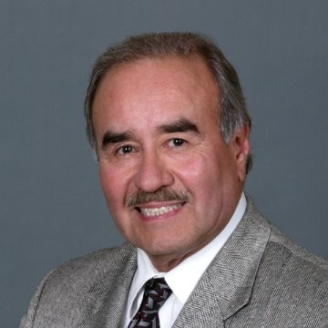
Bidding Successfully
Edward Duarte

Slide 15
Best Practices for Bidding Public Works Mr. Ed Duarte
Notes:
15

Slide 16
Our Objective
An overview on the basic protocol and process of submitting a sub bid
Understand how to develop a comprehensive Scope Letter template that is professional and credible

Slide 17
Finding work & contacting the General Contractors
The SC County website & other Public Agencies
Review the project description & Engineers Estimate
Review the Bid Form List of Bid Items
Prepare your Scope Letter & decide what you will bid upon
Review the List of Primes planning to bid the job
Send the bidding primes your unpriced Scope Letter
Begin working on your estimate
On Bid Day morning, send your priced-out Scope Letter

Slide 18
General Conditions – Key Information
Information to Contractors / Invitation to Bid - (Date, Time, & Place)
Bonding Requirements - (Bid Bond & Performance / Payment Bonds)
The Bid Proposal Form is Always Included in the Spec Book
Description of the Work
Insurance Requirements
DIR Registration & Prevailing Wages required along with Certified Payrolls
Project Labor Agreement (PLA) Requirement - (if any)
MBE / DBE / SBE / WBE / DSVBE / Requirements – (if any)
Contract Completion Time Allowed & Liquidated Damages
Type of CPM Schedule Required
Submittals Requirements – (Number of Copies, Turn Around Time)
Change Order Procedures - (Cost backup, Markups, Disputes)
Weather Days Allowance Policy
Pay Application Procedure / Retention Policy…. (5% per California PCC)
Safety Program Requirements
Covid-19 Regulations are new!
Quality Control / Materials Testing Requirements
Project Close-out Procedures

Slide 19
Process and Protocol
DBEs often feel their bids are ignored, given second class status, or being shopped around.
GC must receive, evaluate, track, and post a multitude of sub bid information
95% of sub bids are submitted in the last hour before bid time.

Slide 20
Process and Protocol (Cont.)
Your Scope Letter should be on your letterhead with the information as shown on the sample.
Preparing a Scope letter in the same format as the Prime’s Bid form is the professional way to submit a sub bid.
Following this protocol will ensure that you receive fair consideration and evaluation of your proposal.
It immediately signals the GC that this bid is from a sub who is at least familiar with the process.

Slide 21
Best Practices
Start your own estimate early, do your Pre-bid Job Walk, quantity take-offs and develop your spreadsheet at least a week before the project bids
Format your spreadsheet to mimic the Prime’s Bid Form as required by owner
Send out your own request for bids from your suppliers & subs
Send your unpriced Scope Letter to the bidding Primes.

Slide 22
Best Practices (Cont.)
Call or email the Prime’s estimator and ask if they received your Scope Letter.
Ask if they have any questions about your proposed scope of work
If you have any questions about the bid, now is the time to ask, not on bid day!
Request that they give you bid results for your trade after the Bid is opened & mention that you will be sending them a Tally Sheet so they can fill in the numbers.

Slide 23
Best Practices When Submitting a Scope Letter
Be as clear and concise as possible
Be sure to structure your pricing to match the format dictated in the Prime’s Bid Proposal
Be sure to reference the Specification Section that applies to your work
Include any and all applicable taxes & freight
Acknowledge all addendums (key)
State any delivery restraints that could affect the schedule
Identify unloading requirements
If appropriate, offer alternate pricing for partial scope, but be clear!
State how long your price is good for (key)

Slide 24
Worst Practices When Submitting a Scope Letter
Do not bid alternate items unless they are approved by the A/E firm
Do not include a detailed quantity take-off unless bid form calls for it
Do not exclude taxes or freight on any of your materials or equipment
Don’t expect that you will dictate payment terms
Do not make a lengthy list of exclusions that are not industry standard for your type of work
Requests for upfront monies are almost never allowed
Do not wait until 15 minutes before bids are due to submit price
Do not wait until bid day to ask questions

Slide 25
Submitting on Bid Day
Finalize your price
Email or fax to the bidding primes 45 - 60 minutes early
The next day contact low bidder & request results
If they used your number and listed you, send a short congratulatory note
Follow the owner’s website to see bid results

Slide 26
?
QUESTIONS
Thank You
Contact Ed Duarte at: edrossduarte@gmail.com
Notes:
26

Slide 27
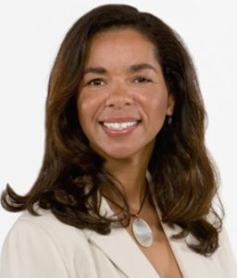
Bonding & Insurance
Ingrid Merriwether, CIC President & CEO / Client Advisor

Slide 28
SANTA CLARA COUNTY
Concrete Solutions for Small Businesses
Insurance and Bonding
Presented by:
Ingrid Merriwether, President & CEO
Merriwether & Williams Insurance Services, Inc.

Slide 29
COST/BENEFIT RISK MANAGEMENT
Removing Barriers to Access
Advocate for business insurance and bonding are forms of financial credit. Access to which is inherently less accessible or costly to minority/small/DBE businesses – Community-Based Businesses.
The ability and extent to which MBE/Small/DBE Businesses have access to insurance/bonding credit, impacts access to public/infrastructure construction contracting opportunities.
And….public agencies diminish their capacity to fully engage the businesses in the community they serve and incur higher contracting cost due to less competition.
GOING PLACES: Concrete Solutions for Small Businesses

Slide 30
COST/BENEFIT RISK MANAGEMENT
Removing Barriers to Access
Conventional Risk Management Philosophy
Management of risk management of risk with predominant emphasis on protecting the organization's financial assets from the cost of risk.
Aligned Risk Management Philosophy
Risk management practice which is aligned with other organizational goals including enabling access, opportunity and inclusion.
GOING PLACES: Concrete Solutions for Small Businesses

Slide 31
COST/BENEFIT RISK MANAGEMENT
Removing Barriers to Access
Removal of barriers like insurance and bonding enables innovation
Public agencies including transportation and infrastructure agencies are more likely to be exposed to unique products or solutions – the by-product of entrepreneurism synonymous with small/DBE and diverse businesses.
Cost of services, including enhanced service solutions, offered more competitively from growing community-centered businesses. This also helps grow local jobs and the local economy – Local Multiplicative Impact.
GOING PLACES: Concrete Solutions for Small Businesses

Slide 32
COST/BENEFIT RISK MANAGEMENT
Removing Barriers to Access
All the aforementioned suggest…
Removing barriers to engage diverse businesses opens new prospects of
opportunity;
inclusion;
positive local economic impact and;
cost savings.
GOING PLACES: Concrete Solutions for Small Businesses

Slide 33
COST/BENEFIT RISK MANAGEMENT
Innovation in Risk Management Examples
GOING PLACES: Concrete Solutions for Small Businesses

Slide 34
COST/BENEFIT RISK MANAGEMENT
How does insurance act as a barrier to small firms?
Small contractors can not obtain insurance needed for large projects
If they can obtain insurance
Small contractors pay substantially more – competitive disadvantage
Don’t have volume of work to support high levels of insurance
Small contractors are more negatively impacted in insurance cost from claims than their larger peers
loss ratios which impact insurance cost, are a factor of premium paid vs claims incurred
the lower the premium the greater the impact of losses- increasing future premiums
GOING PLACES: Concrete Solutions for Small Businesses

Slide 35
COST/BENEFIT RISK MANAGEMENT
What can be done to mitigate these barriers and impacts?
Right-size insurance requirements
Provide project insurance and risk/safety services for all contractors
project coverage for all contractors and owner
project safety program and safety support for smaller contractors
GOING PLACES: Concrete Solutions for Small Businesses

Slide 36
COST/BENEFIT RISK MANAGEMENT
OCIP/CCIP
What is an OCIP/CCIP?
Project owner or GC provides insurance & risk services for all project contractors
General Liability, Builders’ Risk, Professional Liability, Pollution and Other Specialized Coverages (Workers Compensation in some instances)
Used for large projects $100 million+
Focused & project-tailored safety & claims services
How does an OCIP/CCIP help?
Can provide all contractor with a complete package of insurance and risk services.
Levels the playing field for subcontracting opportunities.
removes cost of insurance as a competitive factor
Enables greater subcontracting to small firms.
Mitigates the impact of project liability claims on contractor on-going insurance cost.
GOING PLACES: Concrete Solutions for Small Businesses

Slide 37
COST/BENEFIT RISK MANAGEMENT
How does an OCIP/CCIP help?
A well designed OCIP/CCIP can save 1% to 2% of Total Construction Cost
Gives Smaller Firms More Opportunities as Primes
Supports project goals of inclusion and Small contractor capacity building
Encourages great diversity in contracting and removes a competitive disadvantage for small contractors
Provides benefits to owners and primes contractors too
A win-win in major project risk management
GOING PLACES: Concrete Solutions for Small Businesses

Slide 38
COST/BENEFIT RISK MANAGEMENT
Technical Assistance/Bonding Support
Measured and managed retention – leveraged to enlarge pool of qualified contractors to compete and participate in public construction projects.
How does a technical assistance/bonding & contract financing assistance program help?
Better prepare contractor for bond underwriting or pre-qualification
Consultative Services / Contractor Assessments (Pre-Qualify)
Work-Plan’s and technical support to Maximize Opportunity for Business Improvement
Collateral and Risk Mitigation Support to Enable Bonding or Pre-Qualification
Small contractor support through successful contract completion
Owner supported-project contract financing
Provides Small Contractors access to contract specific working capital
Reduces the financial and cash flow impact of small contractors providing free financing of the owner’s project
Acknowledges the reality that traditional lenders on the whole, lack the ability to finance small contractors
Can enable small contractors to use other credit sources to capitalize business growth
GOING PLACES: Concrete Solutions for Small Businesses

Slide 39
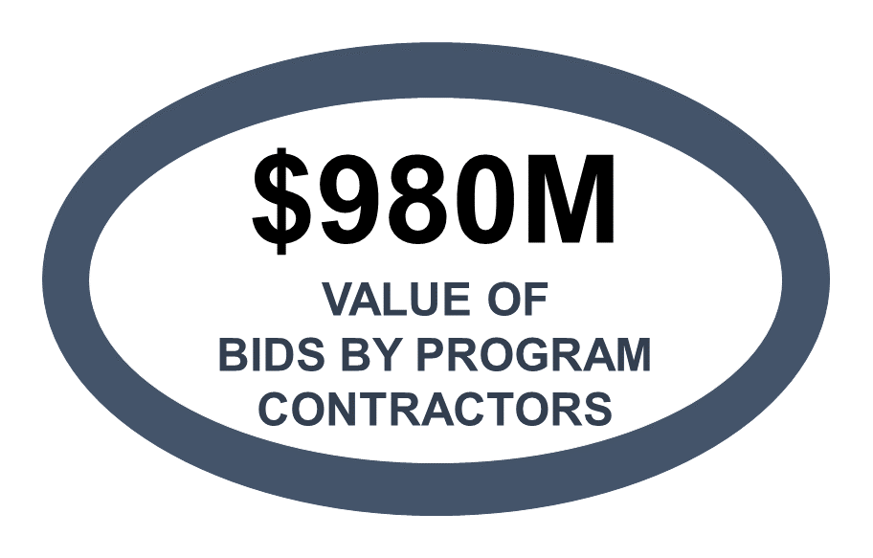
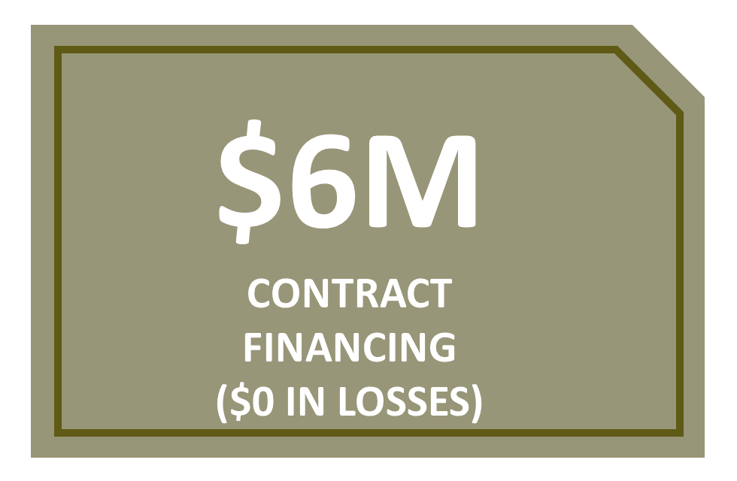
EXAMPLES
Contractor Development and Bonding/Contract Financing Programs Sponsored by Various California Public Entities have:
GOING PLACES: Concrete Solutions for Small Businesses

Slide 40
COST/BENEFIT RISK MANAGEMENT
Conclusion
Management of risk need not be mutually exclusive of enabling access and creating opportunities.
Innovation in risk management practices can open doors and achieve other agency goals including – inclusion & cost savings.
There are solutions which can change the status quo paradigm.
GOING PLACES: Concrete Solutions for Small Businesses

Slide 41
COST/BENEFIT RISK MANAGEMENT
Thank you for your time.
Ingrid Merriwether
President & CEO
Email: Ingrid@imwis.com
415-986-3999
Website: www.imwis.com
Bernida Reagan, Esq.
Director of Community & Client Relations
510-740-6922
Email: Bernida@imwis.com
GOING PLACES: Concrete Solutions for Small Businesses

Slide 42
QUESTION
& ANSWERS

Slide 43
Upcoming Construction Projects
Kim Huynh Contracts Management Division, Facilities and Fleet

Slide 44
Upcoming Contracting Opportunities
Major Public Works (current)
Major Public Works (planning stages)
Tasman Phase 2
Silver Creek
Behavioral Health Services
Minor Public Works
Types of work include general construction trades, concrete, electrical, drywall, plumbing, carpentry, HVAC etc.

Slide 45
QUESTION
& ANSWERS

Slide 46
CONSULTANT

